Slide 1
Accessibility Automation
Challenges and some solutions
#GAAD 2020
#helloa11y

Slide 2
About Me
Web Developer, QA Engineer, Trainer, Advisor love Opensource Bootstrap Accessibility Plugin, AATT, Nemo Accessibility, Skipto, oscommerce…

Slide 3
Purpose of Automating Accessibility Testing
Repeated boring tasks
Product Manager want's a once click solution of testing Accessibility
Few test for Accessibility

Slide 4
Communicate - Break the Myths
Accessibility automation can evaluate roughly 30% of accessibility issues
Its a good start but that is not enough. WCAG checklist like alt text, label, headings, correct aria roles etc. can be automated.
Notes:
Manual Intervention still required to evaluate the alt text, context description, custom widgets behavior, logical flow, focus indicators, keyboard testing, session timing etc.

Slide 5
What could be automated
WCAG checklist
Keyboard testing
Generate AI content like alt text
Notes:
Though Keyboard testing can be automated, it requires plenty of code to be written. Test Engineers are trying to get away from writing code by recording and playing test cases. AI content is still not accurate. Advise stick with WCAG checklist which is the low hanging fruit

Slide 6
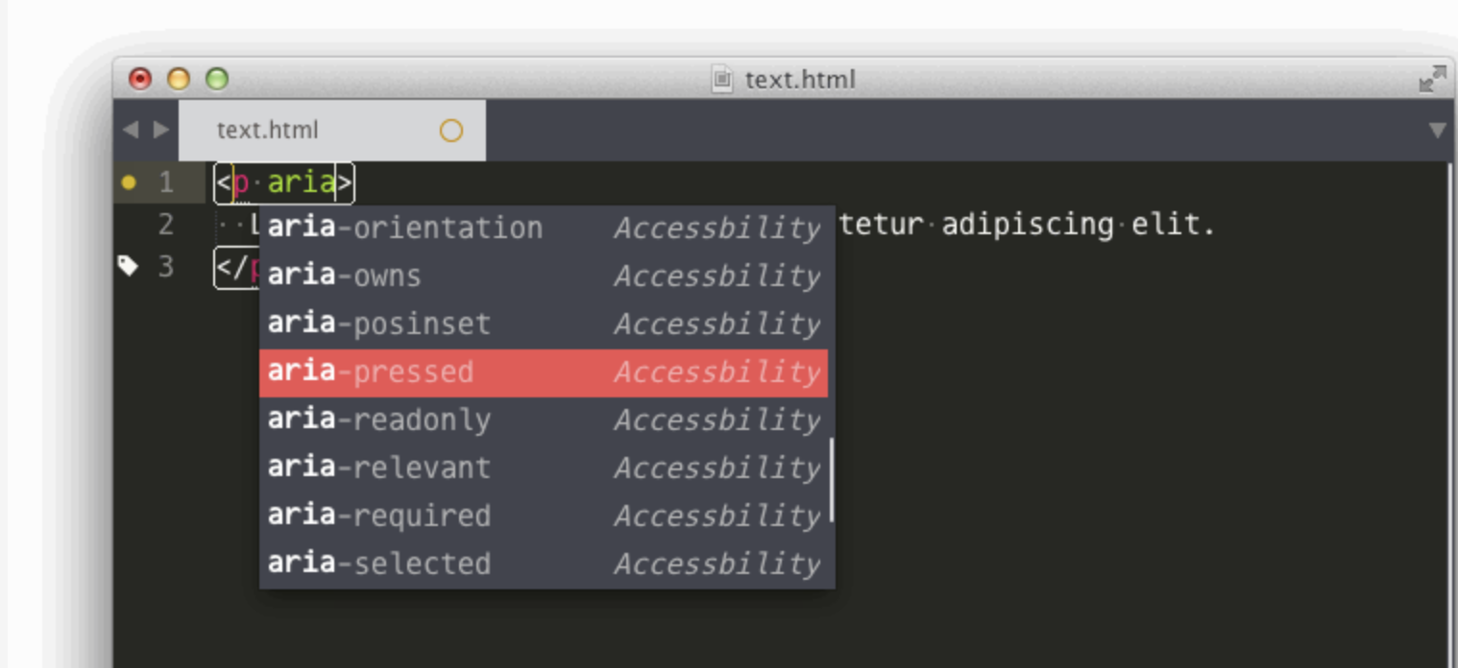
Start from Editors
Notes:
Some of them can help in autofilling

Slide 7
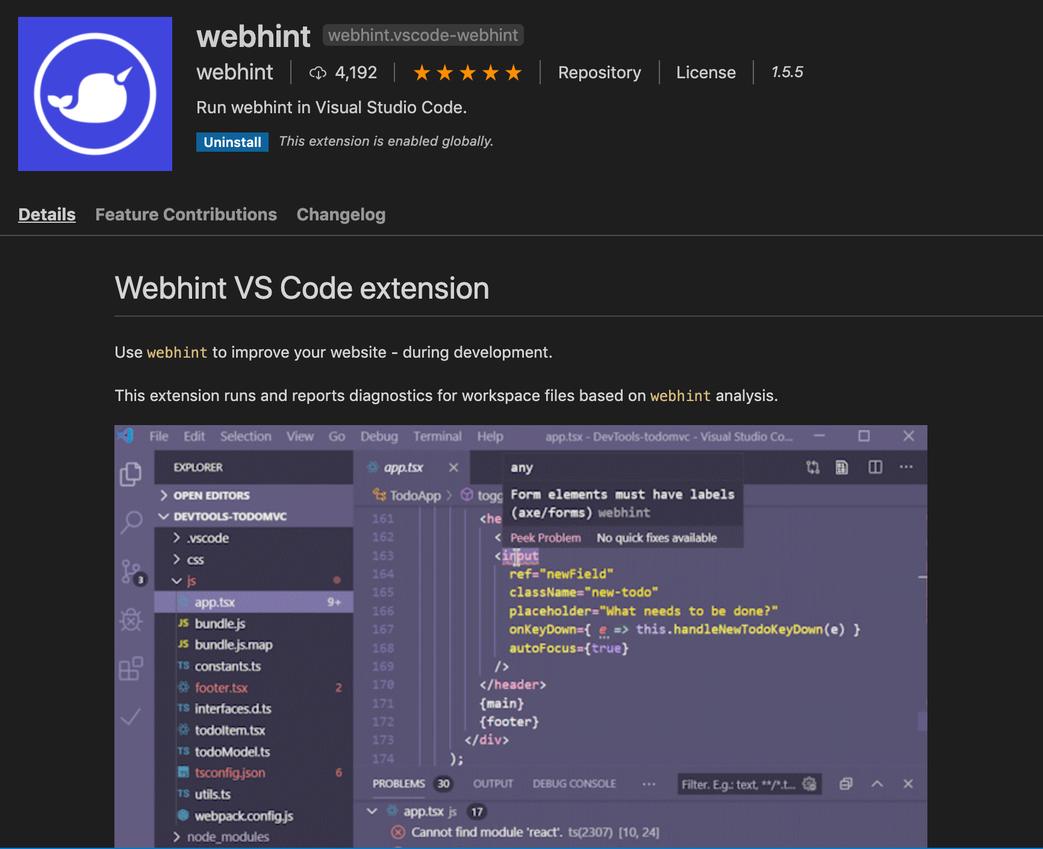
Start from Editors
Notes:
Some of them can help in evaluating code https://github.com/webhintio/hint
https://github.com/mvdschee/web-accessibility
Challenge: Should be able to test the rendered content in the browser.

Slide 8
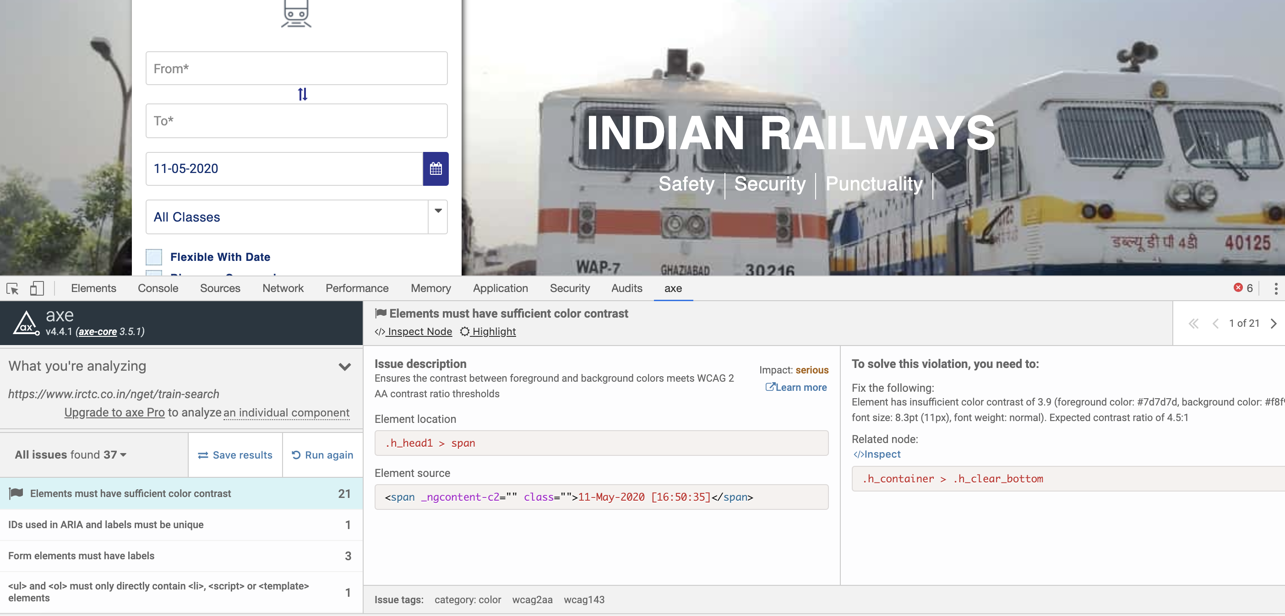
Browser tooling
Notes:
What are your favorite browser tools? Browser Extensions Widely used..
Chrome LightHouse (Quicky)
Wave (Quicky)
WebHint
Microsoft Insights (Pro)

Slide 9
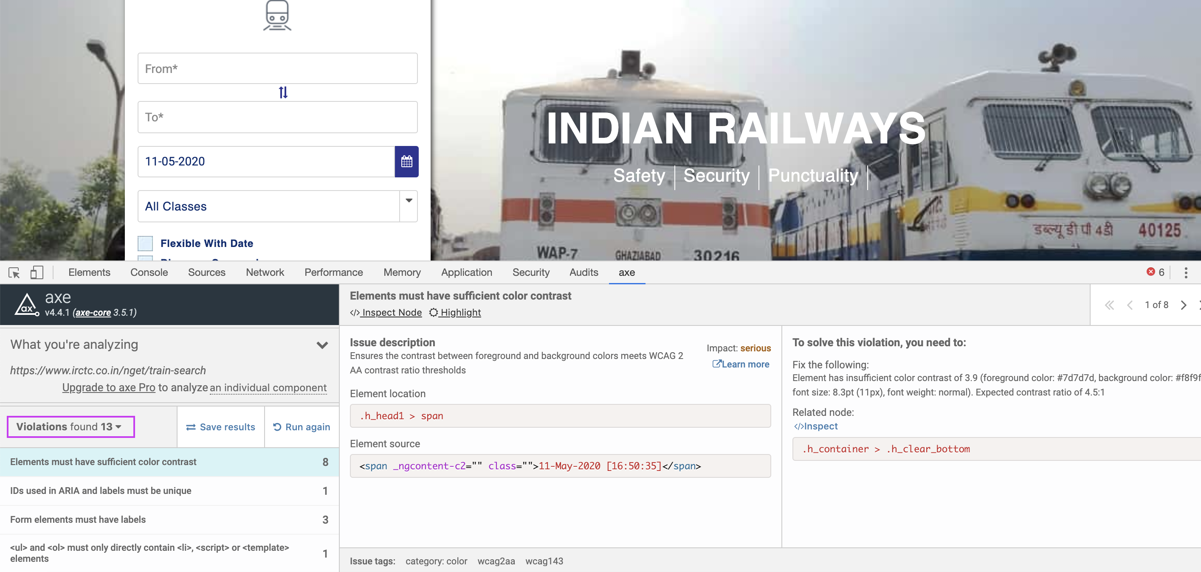
Challenges - Browser tooling
Notes:
The trick when using axe is to always filter by violation. Chrome lighthouse only shows axe violations

Slide 10
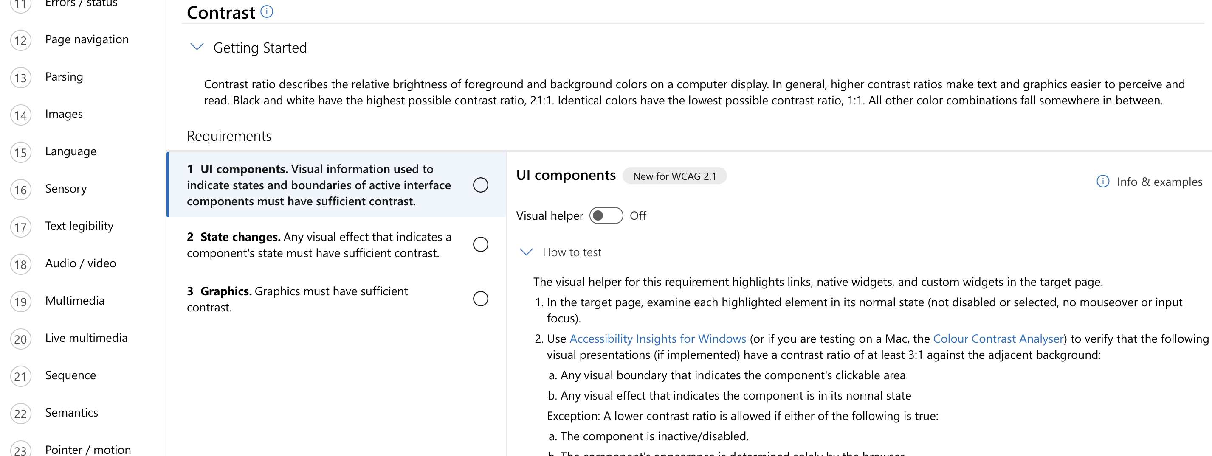
Browser tooling For PRO
Notes:
Microsoft Insights has 24 points checkpoint. Generates a Nice complete report.

Slide 11
Other Challenges
Manually navigate to each URL
Can get skipped.
Testing full website would be a lengthy process
Too many errors and difficult to interpret the results

Slide 12
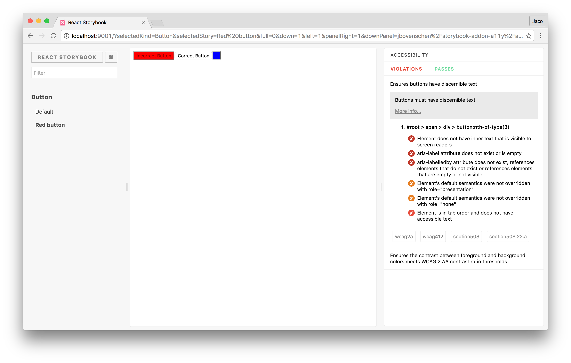
Component Creation
Notes:
For creating UI component use Storybook. Uses React. Axe plugin can be easy configured On the fly gives errors
Uses Axe-core

Slide 13
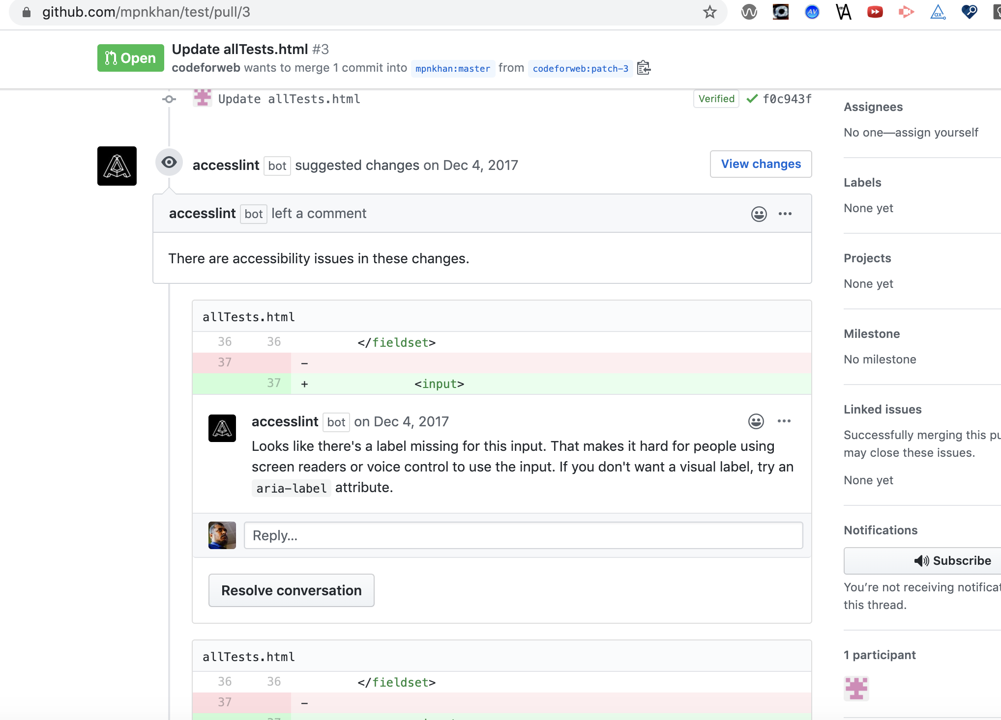
Raising PR
Notes:
We also tries testing while creating PR with AccessLint
Can be installed as Github Application
"When a pull request is opened, AccessLint reviews the changes and comments with any new accessibility issues, giving you quick, timely, and targeted feedback, before code goes live."
Challenge - Doen't work with Dynamic code

Slide 14
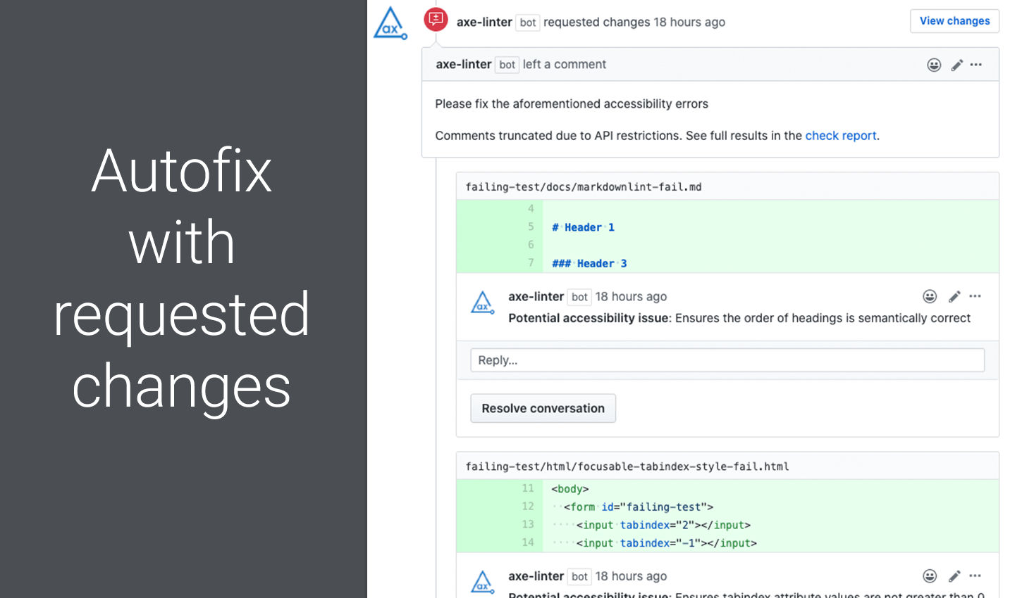
Raising PR – New AxeLint
Notes:
Just Installed – Need to Try Free for Personal sites https://github.com/marketplace/axe-linter https://axe-linter.deque.com/

Slide 15
Test while Building
Selenium based frameworks
PhanthomJS (WebKit) based frameworks
Chrome headless based frameworks like Puppeteer
Notes:
Each has its own advantages and disadvantages. Selenium code breaks frequently because of Wait calls. When the wait time is too less, it breaks the flow and when its too much its very slow. On top of it accessibility evaluation of entire html should be checked. Makes it very slow.

Slide 16
Challenges with Selenium based frameworks
Slow
Breaks frequently
Promise code which has more thenables or await calls

Slide 17
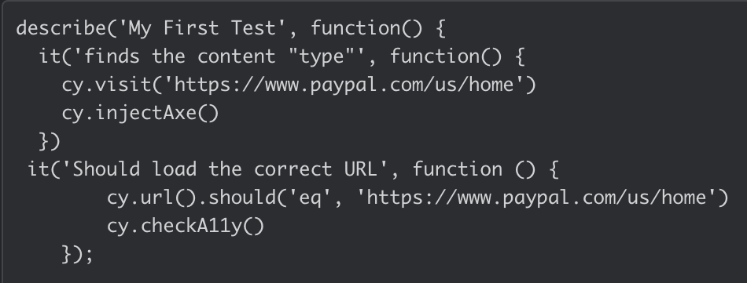
Cypress - promising
Notes:
Few Lines of Code

Slide 18
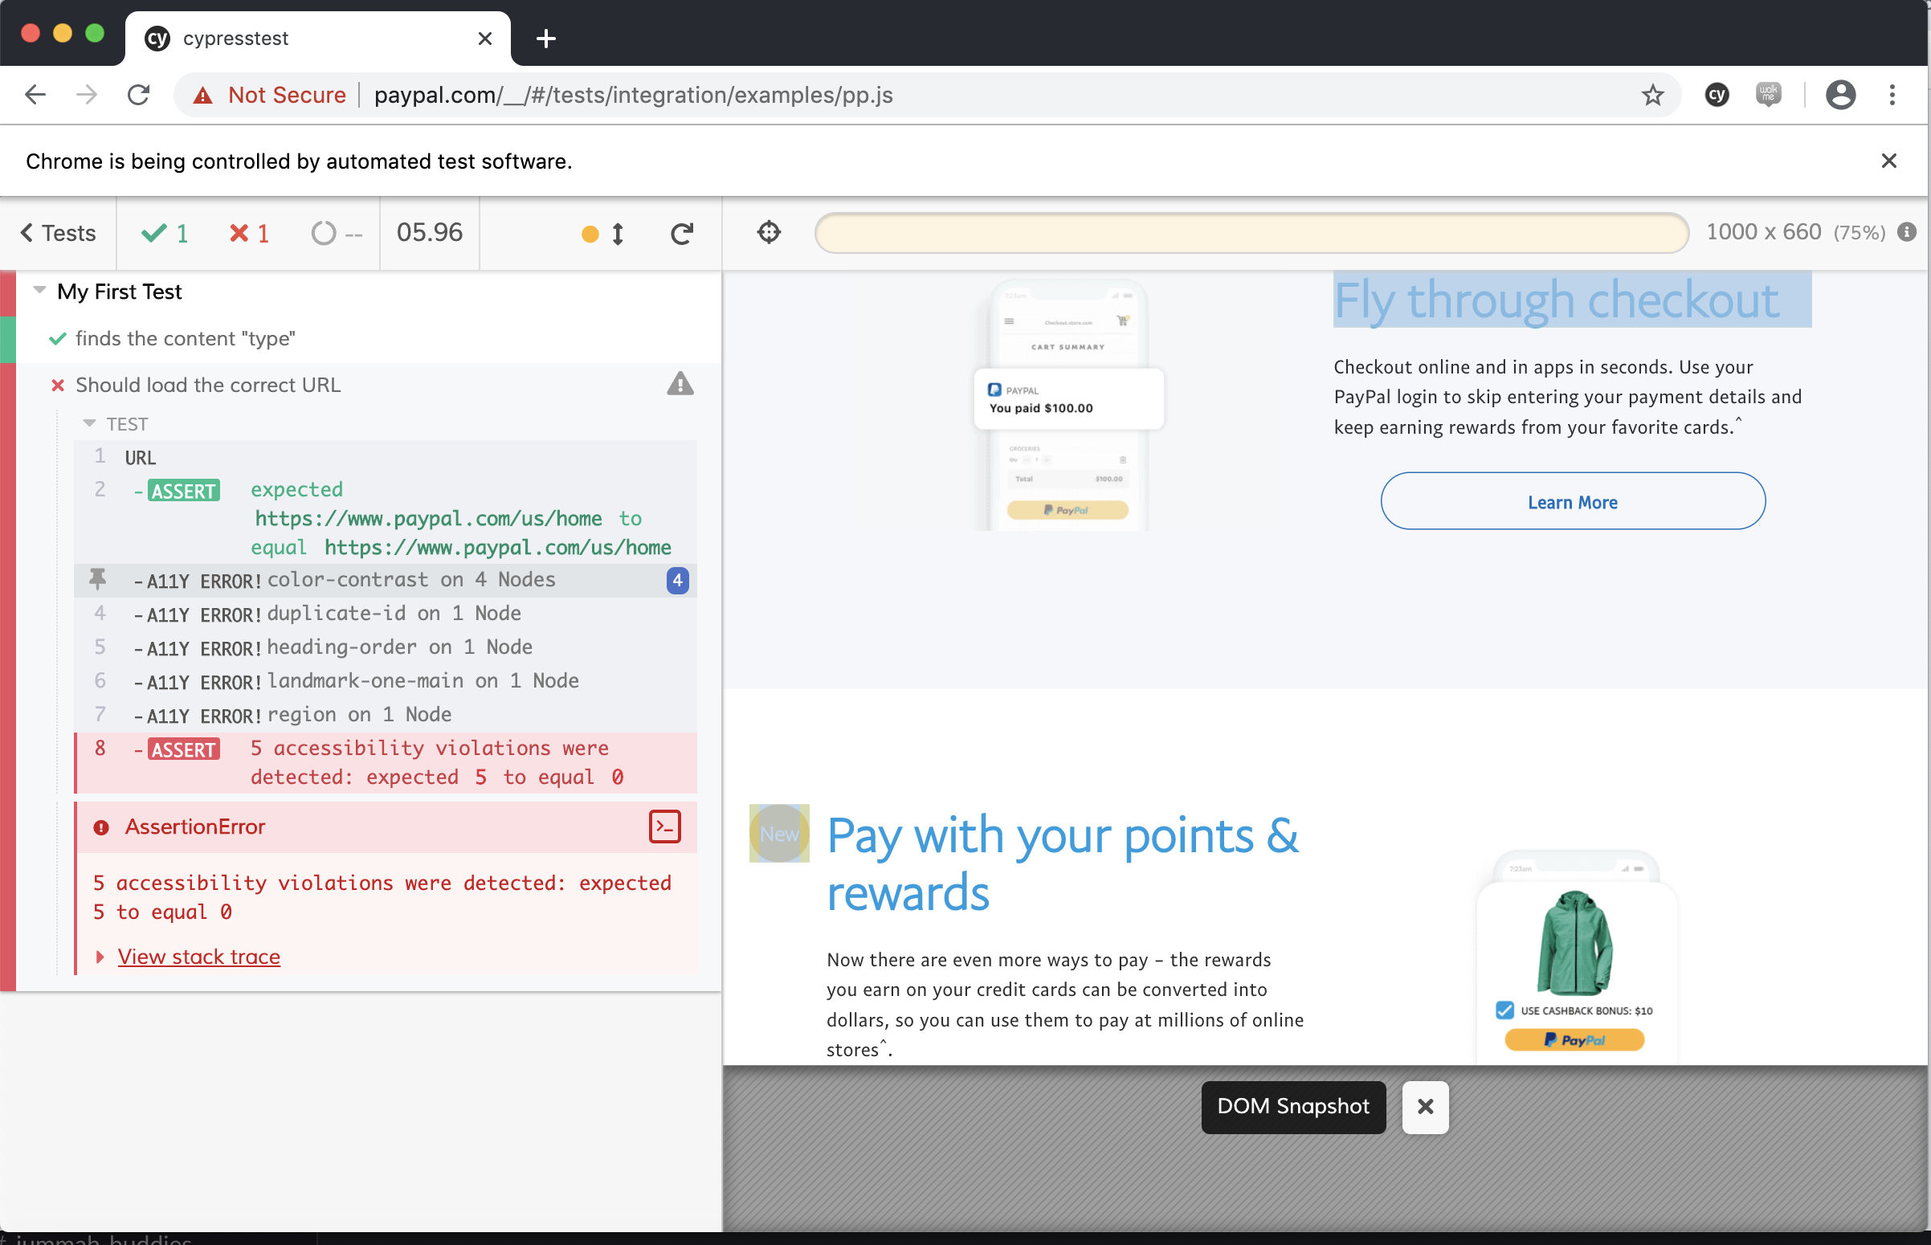
Cypress - promising
Notes:
- Timestamped snapshots at each step, - real-time reloading,
automatic waiting, and
screen & video captures.

Slide 19
Learnings
Automation first approach
Use browser plugins, IDE plugins, Linting as appropriate for your project
Test Manually using Keyboard and Screenreaders

Slide 20

Q&A

Slide 21
Resources
https://www.w3.org/WAI/ER/tools/
https://packagecontrol.io/packages/Accessibility
https://github.com/webhintio/hint
https://github.com/mvdschee/web-accessibility
https://www.npmjs.com/package/@storybook/addon-a11y
https://github.com/apps/accesslint
https://github.com/marketplace/axe-linter

